Slide 1
Digilent (CRA) Test Solution Design Review
TSDR Template Version: 18.0

Slide 2
Standard CRA TSDR-Lite Invitees (Definition Exit), Approval Review
Roles | Name | Approval
R&D Test Engineer | Guy Kang Guan
CRA R&D TE Tech Lead | Phillip Conrad
Global Director of Mfg Test Engineering | Rasheel Karmacharya
Mfg Test Technical Lead | Seth Berry
Mfg Test Engineer
HW Project/Program Manager
Mfg Product Engineer (per site, NIH or PEN):

Slide 3
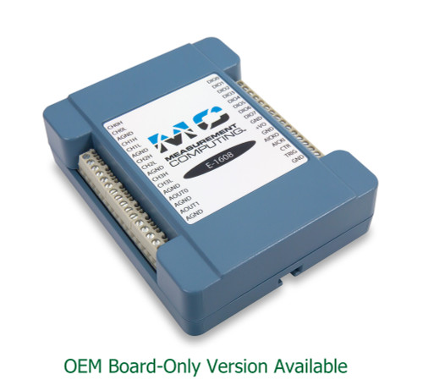
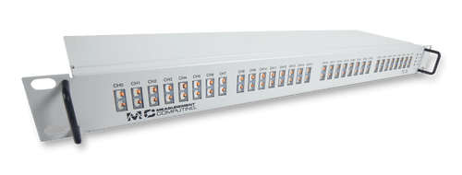
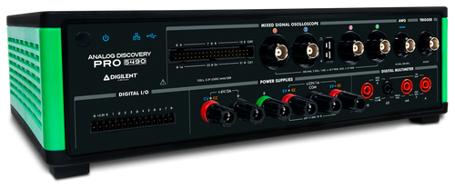
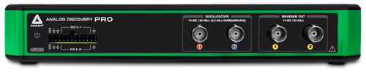
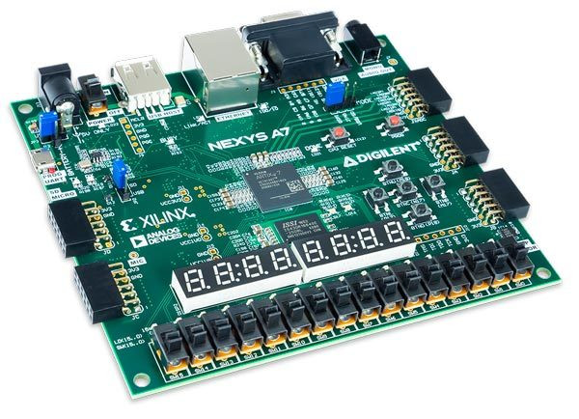
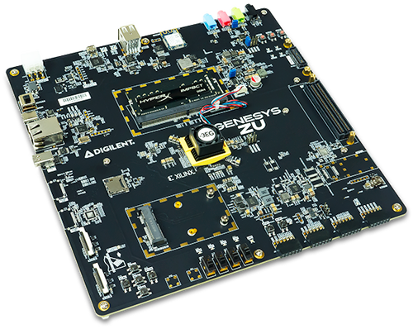
Product Overview
CRA compliance impacted Products:
MCC
E-1608, E-DIO24, E-TC, and TC-32
Analog Discovery Pro Series
ADP54xx and ADP3450/3250
FPGA Board
TBD
MCC Series
Analog Discovery Pro Series
FPGA Board
TC-32
E-1608
Zybo Z7 (Z7‑10 / Z7‑20) Cora Z7 Arty Z7 Eclypse Z7 Arty A7 Nexys A7 Nexys Video Zed board Genesys ZU-3EG/ ZU-5EV
ADP3250
ADP54xx
Nexys A7
Genesys ZU
Notes:
This may take multiple slides and should be pulled from content created by the design team / product planning. Focus on the aspects impacting Mfg.

Slide 4
Secure by default: Digilent Overview Initial password
Devices | CRA relevant | Concept | Work items | Pn count | Details
MCC Series | Yes, Connect code program in EEPROM and default is “0”. | Using SN to generate a unique Passcode and program it to EEPROM. Passcode need printed and label on the product. | New op-seq to label the passcode. Test seq update, TVR and MVR | 4
USRP-2974 | Yes, NI‑provided Linux distribution without pw (x86-64) | Ship without OS |  | 2 | New Desktop Linux; Use password functionality from OS
X3xx, USRP-294x, USRP-295x | No, FPGA update via net, configuration of IP, RUN uhd tools → N/A | NA | Documentation | 7 | Static IP address need direct connection first; used in local network
CDA-2990 | No, Discover, Configuration? → N/A | NA | NA | 3 | Maintenance interface, static local IP address
B2xx | Not relevant; connected via USB | NA | NA | x | Connected via USB
B3xx | Not relevant; direct access via PCIe | NA | NA | x | Connected via PCIe
Notes:
Think about safe mode
Expired password may not work?
Set via serial console Jörg
Also console secured by password?
USRP is not usable until password set?
User management root user?

Slide 5
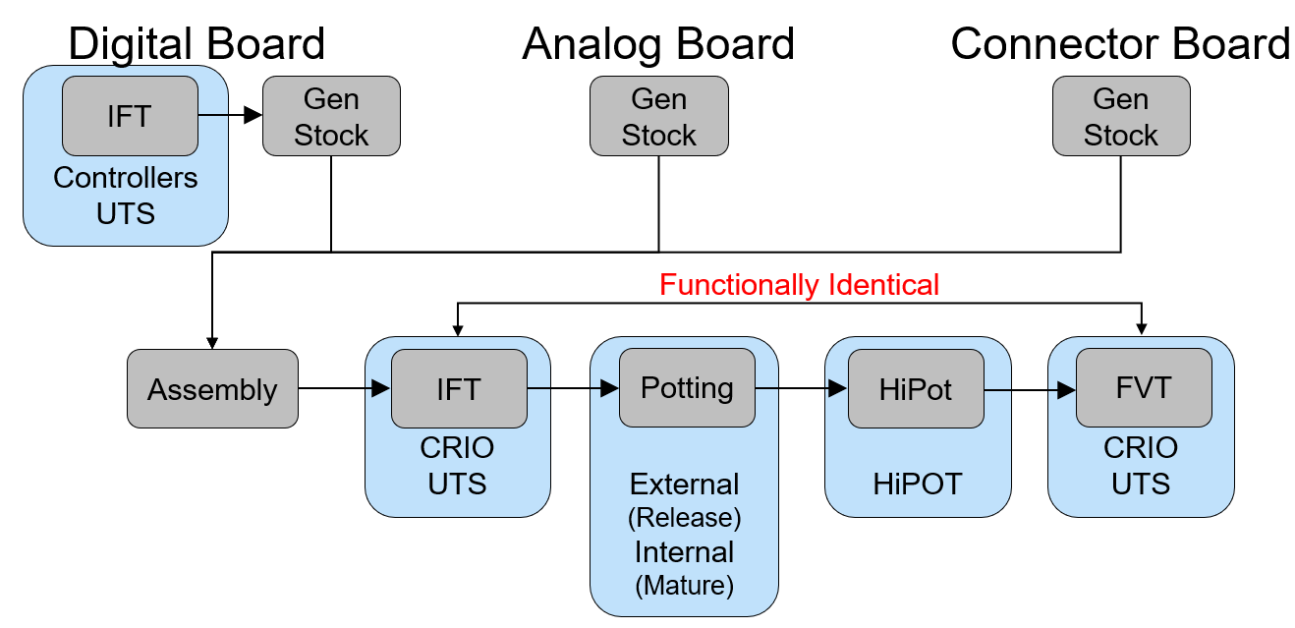
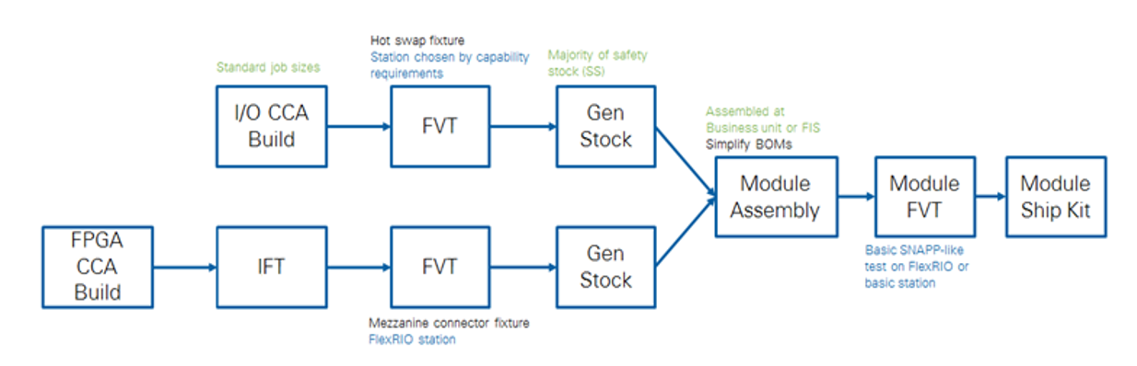
Test Routing / Flow
Green (Committed) | Priority | Yellow (Possible) | Red (Not in this release)
Test
 |  | <Test Time for COGs est.>
CCA <ICT, Built in Self Test, TCT, HIPOT, JTAG, Boundary Scan, etc.> |  | <Description…> <Rationale…> <G / R decision date> | CCA <ICT, Built in Self Test, TCT, HIPOT, JTAG, Boundary Scan, etc.>
Module <ICT, Built in Self Test, TCT, HIPOT, JTAG, Boundary Scan, etc.> |  | <Description…> <Rationale…> <G / R decision date> | Module <ICT, Built in Self Test, TCT, HIPOT, JTAG, Boundary Scan, etc.>
Notes:
This is copied from the HW Features Proposal NPD document and is highly recommended you use the exact same table here for clear communication

Slide 6
Test Design
Leverage existing test design? (proof of existing solution’s reliability)
Collect feedback from MFG (Failure rate, spares, cables etc..)
Check failures (can be eliminated?)
Software
New Test equipment
Focusing on upgrades
Unique/EOL/Obsolete/Phaseout/LTB components
Long lead time items
Affect on existing infrastructure
1 degree room, TCT, special requirements
Affect to production
Validation plan, Upgrades (backwards RMA capability), Downtime
Special knowledge and skills required?
Test coverage? (both for subassemblies (CCAs) and for a single CCA % and module?)
Operator interaction, involvement, complexity
Test station calibration frequency
Notes:
This may take multiple slides
Key Requirements
If we are leveraging an existing test solution (HW, SW) it's reliability discussed and agreed that it's OK to use for future products. Review the following items: • Failure rates/Failures • Manufacturing issues • IQE • CAR • Users (test operators, techs) feedback
List of new equipment, instruments plan to be used. • Be sure the lifecycle is released for all of the equipment planned to be used for the design. • If it is EOL, PhaseOut, LTB or Obsolete, detail a mitigation plan for replacement with owner, dates and cost.
Understanding test solution's infrastructure need. If it requires any extra beside of the existing one on the MFG floors, actions are defined for MFG Test Engineer with timeline to be sure it will be set up by the TVR.
Understand if test solution requires any special knowledge which need to be adopted by MFG Test Engineer before TVR. List in training need section (row 54)
If the product is composed of multiple CCAs, the CCA Test Coverage Plan must be agreed upon by all parties
Level and complexity of test operator involvement during the test are understood
Calibration cycles and calibration capabilities understood (inhouse vs. 3rd party calibration)
Share all possible test design options

Slide 7
Test Station Capacity (3-year)
Include:
Test station name
Test station description
Three-year capacity calculated per month, using a 5 day, 2 shift model (use similar test solution availability
Use year 2 estimate from Kinaxis for year 3 estimates
Test times (operator interface)
Set up concerns (for every products)
Parallel test option?
Failure rate
Duplication plan (resources) in place
Both production and MFG Services
Consider any anticipated spikes in 7 years
Debug considerations
Calculate w/ station calibration downtimes
EXAMPLE
To be filled out by the Mfg TE
Notes:
Any / All product forecasts should use the “Unconstrained Upside” scenario. This will come from the Planning Team.
Forward-looking station capacity should include:
Expected capacity at project release (for each asset) with delta due to the new product(s)
Expected capacity at Ship & Ramp exit (for each asset) with delta due to the new product(s)
Provide an additional visualization for station utilization with the y-axis at 100% if necessary to communicate risk.
Product's forecast, Test time & Failure rate estimations provided
Test capacity is adequate to process the projected forecasts. This includes test station, test kits, and any related equipment. (Be sure that calculation contain all existing volume running on test equipment and the possibility of product cannibalization)
If test capacity not enough duplication plan provided, including cost, timeline, and resources
Plan to have a debug solution (separate from Test solution) for product debugging purposes discussed
Plan to have test solution debugging tools (including HW, SW) discussed

Slide 8
Cost
CAPEX cost
Debug equipment
Spare cost
POT
Extra Infrastructure cost
Deferred cost because of upgrades (when multiple stations are affected globally, including MFG Services sites)
Location of deployment because of asset threshold
Budget: What is budgeted vs. not
Notes:
Work with Project Manager on the Debug equipment and POT costs.
Work with Mfg counterpart on infrastructure costs.
Key Requirements
Capital equipment cost is captured in the TSDR slides.
CAPN request(s) have been created in TETRA and are content-complete.
All CAPNs have been reviewed by R&D Test and Mfg Test.
CAPN(s) should be ready for final approval prior to TSDR meeting.
Document all CAPN numbers and project numbers within the slides
Estimation for annual maintenance cost (including calibration, spares)
Purchasing POTs for use in Manufacturing Production is the responsibility of the Manufacturing Test organization.
If test solution requires upgrade globally, cost is understood and approved by all affected site (including MFG services). Cost must be captured in TSDR slides.
Debug equipment cost is captured in the TSDR slides.

Slide 9
Test Solution Validation plan
GR&R?
Releasing w/o GR&R so no reference for future duplications
Number of runs, number of test equipment to compare?
Where to get the products from?
MVR or PRT units?
Can we hold up MVR to run GR&R?
Having Omni scripts available
What support needed on site?
What’s time frame to complete?
Special FCO rollout plan (like Sprint deployment)
Understanding the risks!
Describe plans for:
Reviews of test station hardware design
Reviews of test software (code, sequence, approach, algorithms, etc).
Describe plan for determining compatibility of the new test stations with existing products.
Who will be involved, and when in the development cycle will they be held? Any special concerns or focus areas (new approaches, code re-use, etc.)
Describe applicable plans for:
Fault Insertion Testing
Cpk
Continuous Loop Testing
Usability Reviews
Notes:
Key Requirements
GR&R requirements defined (# runs, # test equipment to compare), risks understood
Products for GR&R provided by: [ ] HW Team [ ] Units from MVR job
Validation plan affect on production discussed (downtime when test equipment not available for production)

Slide 10
RMA support, MFG services
Test routing for RMA
Multistep RMA
Special instructions?
Do we want to capture as-found data?
Must have for release! (MVDB deliverable)
Understand RMA capability need on satellite sites! (upgrade plan provided)
CSC support?
Work with HW Services to determine a ramp-up plan based on forecast
Required for PPA meeting, do not delete
Notes:
Work with project manager to learn if CSC support is required or PEN/NIH RM
Key Requirements
RMA test routing is defined for the product and verified to match in all source locations.
All possible special instructions for RMA discussed
Roll out plan discussed for RMA test at satellite sites (not the build site)

Slide 11
Safety / Ergonomics
Safety
Test Asset #1: <Safety Ticket Link> <DQP-0153 Link>
Test Asset #2: <Safety Ticket Link> <DQP-0153 Link>
Test Asset #3: <Safety Ticket Link> <DQP-0153 Link>
Test Asset #4: <Safety Ticket Link> <DQP-0153 Link>
Overall HLD Safety Review(s) Outcome:
“Go” or “Conditional Go”
Risks captured in Safety Risks Matrix
Ergonomics
Requirements – referring to DfMT
Satellite site facility requirements discussed
Required for PPA meeting, do not delete
Notes:
Key Requirements
For every new Test Asset proposed at TSDR (Stations, ITAs, Fixtures, CCAs, etc) the following must be complete:
A Safety Ticket has been generated
Use the Test Asset Safety Ticket generation form: https://forms.office.com/r/79QqY2E3iE
A Hazardous Asset Checklist is complete & attached to the Safety Ticket
The Checklist is attached to Agile Part Number ‘DQP-0153’: https://niecho.natinst.com/part/attachments/380800175/380800177
A HLD Safety Review has occurred with the Safety Team
High Level Design files are discussed with the Safety Team in a meeting-format
Safety identifies Risks as well as a “Go”, “Conditional Go”, or “No Go” decision
HLD Safety Review(s) Outcomes:
“No Go” decision - TSDR must not be held until a redesign has occurred.
Either “Go” or “Conditional Go” decision – TSDR can move forward with Safety Risks captured in the Safety Risks Matrix on the next Slide
Safety Risks captured need Azdo items for tracking, with Azdo items captured in the Notes of the Safety Risks Matrix on the next Slide
Recommended to link the Azdo Risk items to the matching Safety Ticket as “Related” to increase their visibility during Execution.
Considerations during Execution:
Safety requirements & instructions are followed during test design (Reference: 270531A-01 section 10.6)
Ergonomics taken into consideration during Test Solution Design (Reference: 270531A-01 section 7.2)

Slide 12
Manufacturing Executive Summary Slide
Key Risks to On Time Release
Key Risks for Sustaining
<Summarize aspects from the TSDR that Mfg Test leadership should be aware of related to releasing the product to Manufacturing in line with the project schedule>
<Summarize aspects from the TSDR that Mfg Test leadership should be aware of related to sustaining the product over time>
To be filled out by the Mfg TE

Slide 13
SECTION INSTRUCTIONS
The slides contained within this 'Only Present If Required' section must always be filled out to completion paying attention to additional information within the slide notes as well as any relevant information within the Test Set Handoff Checklist's Test System Design Review Sheet.
If any of the content in the slides is deemed High-Risk, New, Unique, Difficult, or Different, the slide(s) should be moved into the 'Must Be Presented' section.
If a slide does **not** contain information that is High-Risk, New, Unique, Difficult, or Different, the slide(s) should be moved into the 'Pre-Read Only' section.
When complete, the 'Only Present If Required' section should contain **no** slides.

Slide 14
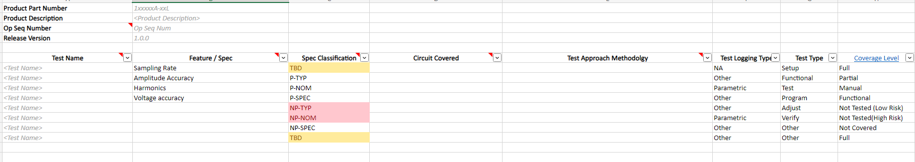
Product Spec Coverage
An overview of proposed tests as they relate to product specifications.
All specifications should be considered. It is recommended to add ‘Notes’ for KEY specs, tests that most impact the cost of the solution, and test that most impact the execution time of the solution.
Links to any technical deep dive information on spec coverage is useful (AzDO or Product Test Specification).
Product Test List Template

Slide 15
Coverage Risks and Mitigations
Any product specifications that will NOT be covered should be listed here, along with any potential mitigation plans.
Description | Risk | Reason | Mitigation Plan
SMU sense and DMM measurement at switch matrix. | Low | The test setup did not have probe plate CCA so no relay for shorting at very near DUT. SMU remote sense lines join to source lines at switch matrix. DMM also measures at switch matrix. These voltage measurement may differ to what DUT measures, and not able to test / calibrate up to the requirement. The risk should be low as USB-600x test is using same setup. USB-6218/6349 setup also similar with PXI-250x multiplexer. | Since the risk is low, no plan for this. Add probe plate test CCA with relay will be add cost and development time to already tight schedule. Depend on the results, maybe need to widen test limit to compensate.
Partial coverage for voltage regulator and reference | Low | The test setup is unable to access these, so they are not tested directly. However, if any issue with these circuitry will disrupt the power sequence and other tests will fail. | None
Partial coverage for digital chips | Low | FPGA, FX3, microcontroller, flash etc are not tested directly, got any issue will cause DUT detection and functionality fail. Some of them required programming so will be verified too when programming success. | None
No Coverage for USB SS Protection Diodes | Low | The test setup is unable to access these, so they are not tested. After discussion, it’s okay to not cover these as they are only for ESD protection. | None. It will be very difficult to route out the USB SS lines to test. Will rely on AOI inspection to check.
NimbusDAQ Coverage Gaps Example
Notes:
Add a table of the high-risk items and some examples of what can be done to improve coverage or reduce risk. Show new coverage value if the risk mitigation plan is executed. This is a discussion and negotiation.
Adding coverage, not reducing risk.

Slide 16
Long Lead Items
Item Description | NI Part Number | Mfg Part Number | Lead Time | Required Quantity Per Set
Notes:
Long Lead Times are defined to anything requiring >= 3 months to acquire

Slide 17
Debug Solution
Product
What is the debug strategy? (maybe not available at TSDR, more sync up needed before MVR ~2-3 months)
Leverage production solution
Separate debug solution
Fixtures, adapters etc. from V&V, HW teams (agile?)
Special equipment (PCB, probes etc…)
Debug VIs
Test Solution Debug
Tools to make test debug easier

Slide 18
Maintenance, spares
PM Timeline (time vs. utilization based)
Calibration requirements, plans (station, instruments, artifact calibration)
Revisit calibration cycles
Inhouse vs. 3rd party calibration capabilities
Spare requirements
Capture recommendations for spares on following slide
Focus on long lead time items
Consumables (quick connects, cables, connectors etc..)
Global availability (lifecycle), suppliers? local suppliers?
Cost for budgeting (associate cost for project?)
Notes:
Are you using unique equipment (not used on any other station)?
Be aware of calibration time remaining once equipment delivered to Mfg. Should R&D rent equipment to ensure re-calibration prior to shipping?
Spare parts list defined (including consumables and instruments)
Spares’ suppliers must be verified to be available locally and positively documented within the slides
Preliminary Preventive maintenance plan discussed and agreed

Slide 19
Modernization The Test Solution REQUIRES / DOES NOT REQUIRE Modernization
Modernization Plan Details
Effort
Schedule
CAPEX cost
Modernization Execution Schedule (pick one, delete the others)
Will Occur During Release
Will Occur After Release, but before Ship & Ramp Exit
Will be captured in a modernization plan, but defer execution indefinitely after NPD (with Mfg agreement)
List of Test Assets Requiring Modernization
Test Asset | Link to MDR AzDO Item | Exception Approved?
See TSDR Checklist
for full directions
Notes:
-If MDR assessment complete
-may be superset of what is needed to modernize a station (i.e. includes modernization for multiple products)
-identify subset that would be needed for NPD modernization support
-work with MDR and HW Leads/Station owners to determine appropriate approach/scope for modernization
The table is used to capture all Test Assets which either:
* Require Modernization
* Would require Modernization but has been granted an Exception
The full list of Test Assets is captured in the following slide

Slide 20
High-Cost Spares
Identified during Planning
Item Description | Estimated Lifespan | Effect Of Wear | Notes
Notes:
High Cost Spares are defined as equipment that must be capitalized (e.g. requires a CAPN)

Slide 21
Test Eng. CapEx & AR (>$1k) Equipment List & Timeline
Cost Center | Site | CAPEX Item Description (Requipment, NRE, Tooling) | Owner | Budget Code (if assigned) | Cost (USD) | Depr. (3yr, 5yr, 7yr) | Purchase Fiscal Quarter/ Year | In-Service Fiscal Quarter/ Year | Other Options Considered, Additional Notes
2053 | NIC | Development ITA | R&D Test Eng. | <Some number from Finance> | $7,000 | 5 yr. | ‘25 Q2 | ‘25 Q2
2053 | NIC | Development Fixture | R&D Test Eng. | <Some number from Finance> | $23,000 | 5 yr. | ’25 Q2 | ’25 Q2
2053 | NIC | Probe Spares and Tools | R&D Test Eng. |  | $1,500 | NA – OpEx | Q3 '27 | Q3 '27 | Spare XProbes + Insertion/Extraction Tools
2053 | NIC | Safety Verification Test Equipment* | R&D Test Eng. |  | $1000 | NA -Opex | 25 Q2 | 25 Q2
TOTAL: |  |  |  |  | $30,000
EXAMPLE ENTRIES; DELETE AND FILL IN CORRECT VALUES
Capital Equipment Guidance
Required for PPA meeting, do not delete
Notes:
All project expenses over $1k, including OpEx (equipment between $1k and $1.5k, software, NREs, etc.) must be listed here for inclusion in the overall project AR.
If a line-item is OpEx, list `NA – OpEx` in the Depreciation column.
CapEx is any equipment with $1.5k minimum cost with useful life of 3 yrs or greater (equipment between $1k and $1.5k is OpEx but should also be included in the list).
- CapEx cashflow occurs during the Purchase Fiscal Quarter
- Monthly depreciation starts in the In-Service Fiscal Quarter
- If Capex is > $100K, work with PR&D project team to complete an Economic Evaluation (ROI) with Finance
*Note - “Safety Verification Test Equipment” line item is intended to cover HW needed to perform Safety Verification Testing on new test assets.
- Expenses for safety testing under $1k are OpEx expenses that don't need to be captured here.
- Expenses over $1k should be listed here and included in the project AR.
- Individual items over $1.5K are depreciating CapEx expenses and should be listed as such above.

Slide 22
Mfg. CapEx & AR (>$1k) Equipment List & Timeline
Cost Center / Account | Site | CAPEX Item Description (Requipment, NRE, Tooling) | Owner | Budget Code (if assigned) | Cost (USD) | Depr. (3yr, 5yr, 7yr) | Purchase Fiscal Quarter/ Year | In-Service Fiscal Quarter/ Year | Other Options Considered, Additional Notes
1070 | NIH | Mfg ITA 1 | Mfg |  | $7,000 | 5 yr. | Q3 ’25 | Q4 ‘25
1070 | NIH | Mfg Fixture 1 | Mfg |  | $23,000 | 5 yr. | Q3 ’25 | Q4 ’25
1070 | NIH | MEAS Station Upgrade Items | Mfg |  | $5,000 | 7 yr. | Q3 ’25 | Q4 ’25 | Adds required instruments
1070 | PEN | MEAS Station Upgrade Items | Mfg |  | $5,000 | 7 yr. | Q3 ’25 | Q4 ’25 | Adds required instruments
1070 | NIH | Mfg ITA 2 | Mfg |  | $7,000 | 5 yr. | Q3 ’27 | Q3 ’27 | Based on predicted forecast growth
1070 / 780000 | NIH | POT Unit(s) | Mfg |  | $23,000 | 5 yr. | Q3 ‘27 | Q3 ‘27 | <List all recommended POT variants for purchase>
1070 / 780001 | PEN | Probe Spares and Tools | Mfg |  | $1,200 | NA – OpEx | Q3 '27 | Q3 '27 | Spare XProbes + Insertion/Extraction Tools
TOTAL: |  |  |  |  | $70,000
EXAMPLE ENTRIES; DELETE AND FILL IN CORRECT VALUES
Capital Equipment Guidance
Required for PPA meeting, do not delete
Notes:
All project expenses over $1k, including OpEx (equipment between $1k and $1.5k, software, NREs, etc.) must be listed here for inclusion in the overall project AR.
If a line-item is OpEx, list `NA – OpEx` in the Depreciation column.
Cost Center / Account Guidance:
- POTs for Mfg should use CC 1070, Acct 780000
- Spares should use CC 1070, Acct 780001
- Debug Solutions should use CC 1051
CapEx is any equipment with $1.5k minimum cost with useful life of 3 yrs or greater (equipment between $1k and $1.5k is OpEx but should also be included in the list).
- CapEx cashflow occurs during the Purchase Fiscal Quarter
- Monthly depreciation starts in the In-Service Fiscal Quarter
- If Capex is > $100K, work with PR&D project team to complete an Economic Evaluation (ROI) with Finance

Slide 23
Safety Risks Matrix Notes: AzDO Item numbers are captured in Slide Notes for each Risk See Slide Notes for classification of Impact and Likelihood of Mitigation Failure
Risk Name Description | Severity (1-5) | Mitigation(s) | Likelihood of Mitigation Failure (1-6) | Risk Ranking (Higher = Larger Risk)
Risk #1: Power through VPC Unclear if VPC design satisfies safety requirements to carry Power signals, as parts are uncertified. | 4 | Mitigation #1: Qualify Power through VPC for the Floor Work with Safety to provide appropriate design considerations and evidence to alleviate concerns. Work with Safety to drive down unknowns to increase probability of success. | 4 | 16
 |  | Mitigation #2: Move Power Connectivity Move Power connections off the VPC Power interface and onto a safety compliant interface. Work with Safety to develop custom cable adapters to achieve required DUT connectivity. Reduces ease of hardware use and is less elegant for manufacturing use. | 3 | 12
Risk #2: Instrumentation Missing Safety Certification Instrument Manufacturer confirmed that acceptable safety certifications are being pursued and will be completed within project timeframe. May be delayed or fail, rendering the instrument unacceptable for use. | 4 | Mitigation #1: Wait for Safety Certification Lease demo units for development, purchase and populate post-certification units | 2 | 8
 |  | Mitigation #2: Select another Instrument Should the certification fail or be delayed beyond acceptable dates, design out the instrument in favor of another which already carries acceptable certification. This would likely carry a significant redesign burden. | 2 | 8
Risk #3: Fixture Design includes Pinch Points DUT Engagement mechanism of the test fixture requires using pinch points exposed to the operator | 2 | Mitigation: Work with ME Team to eliminate Pinch Points Engage with the ME team to ensure considerations for additional guards or enclosures around pinch points are accounted for; may reduce useability/increase fixture design complexity | 1 | 2
EXAMPLE ENTRIES; DELETE AND FILL IN CORRECT VALUES
Required for PPA meeting, do not delete
Notes:
Risk AzDO Items:
Risk #1: AC Power through VPC- AzDO #<XXXXX>
Risk #2: Instrumentation Missing Safety Certification - AzDO #<XXXXX>
Risk #3: Fixture Design includes Pinch Points– AzDO #<XXXXX>
Severity Classifications
1: Very Low
2: Low
3: Medium*
4: High
5: Very High
Likelihood of Mitigation Failure:
1: Rare
2: Unlikely
3: Possible
4: Likely*
5: Almost Certain
6: Certain
*Note – Risk items with Severity below 3 (Medium) or Likelihood of Mitigation Failure below 4 (Likely) should be captured as Azdo work items and addressed during the project, but do not need to be discussed during the TSDR.

Slide 24
Special Considerations
This should discuss any special considerations that may impact the MFG test requirements or test solution for the product. Examples of special considerations for a product may include test time requirements for the MFG test process, temperature or environmental concerns which may impact test, or equipment needs that which may be outside of the general MFG test process.

Slide 25
Other
Special licensed items (controlled functionality on instruments)
Detail whether a Debug solution is needed

Slide 26
SECTION INSTRUCTIONS
The slides contained within this 'Pre-Read Only' section must be filled out to completion, paying attention to additional information within the slide notes as well as any relevant information within the Test Set Handoff Checklist's Test System Design Review Sheet.
All slides within the "Pre-Read Only" section should not be presented at the TSDR unless an approver requests that topic be moved to the presentation section for discussion, either during the pre-read period or the meeting itself.

Slide 27
Required TSDR Invitees
Attendee Role | Name | Attendance Required?
HW Project/Program Manager | <Fill in before TSDR> | Yes
R&D Test Engineer | <Fill in before TSDR> | Yes
R&D Test Manager responsible for the product | <Fill in before TSDR> | Yes (or Delegate)
Mfg Test Engineer | <Fill in before TSDR> | Yes
Mfg Test Engineer's Manager | <Fill in before TSDR> | Yes (or Delegate)
Mfg Product Engineer | <Fill in before TSDR> | Optional (w/ Pre-Read)
Mfg Liaison | Peter Veres for NIH projects Tameem Khan for PEN Projects | Optional (w/ Pre-Read)
Global Director of Manufacturing Test Engineering | Rasheel Karmacharya | Yes (or Delegate)
Manufacturing Test Technical Lead | Seth Berry Aparna Satyavolu (for RF projects) | Yes
Test Equipment Safety Reviewer | Balazs Daroczi | Optional (w/ Pre-Read)

Slide 28
Estimated Test Times
Provide an estimate of product test time. Test time should be inclusive of the optimal “cycle time”, defined as the best start to start sequential testing per routing step. Cycle Time estimates includes time required for operator interactions and dependencies.
Setup & Teardown Time is the time required to prepare the station to test the product at that op sequence (from scratch) plus the time required to return the station to the previous state.
Op Seq # | Name | Failure Rate (%) | Setup & Teardown Time | Test time (including DUT change time) | Oracle Item Time TestTime*(1+FR) | Comments
140 | FVT | 10% | 20min | 3min | 3.3min
Total:

Slide 29
Modernization Comprehensive Test Asset Summary Table
Asset Name | Asset P/N | Requires Modernization? | Summary of Modernization Effort | Has Mfg granted an exception? If so, Who?
Rear Expansion Module Breakout Board | 123456A-01L | Yes | EOL ICs, Needs Emerson Branding | No
Chassis FVT ITA | 234567B-02L | Yes | EOL resistors on internal CCA | Yes – Seth Berry
Chassis UTS | 111111A-01L | No | N/A | N/A
EXAMPLE ENTRIES; DELETE AND FILL IN CORRECT VALUES
SEE SLIDE NOTES FOR INSTRUCTIONS
Notes:
List out **all** test assets (defined below) which will be utilized by the proposed solution (examples include Stations, ITAs, Fixtures, CCAs, etc.) on their own row and indicate whether they require Modernization, filling out the table as needed.
For any assets that list 'Yes' in the 'Requires Modernization?' Column (even if they were granted an exception), include those in the previous Modernization slide.
Definition:
* A test asset is any station, fixture, ITA, or other piece of test equipment or hardware used to test the products in this TSDR.
* Multiple pieces of hardware in one logical grouping can be covered by one line (e.g. if multiple custom CCAs in a fixture have EOL components, those issues can be covered by a line item for the fixture.
* At the TE's discretion, items can be listed on separate lines if those items warrant specific consideration.

Slide 30
Software
Test image
New image vs. existing (validation plans, regression testing)
Number of images on the station (HDD, SSD limitations)
OS
<New driver at TVR/MVR> - released / unsigned / signed
Programming languages
LV <version & bitness> (HTAP or not)
Python
<Scripting>
Framework
BlueNITE <version & bitness>
TestStand <version & bitness>
Licenses requirement (like: JTAG)
Special requirements / knowledge
External programming (like SDR SD card in PEN)
Systems level test
CASCON modifications
Host-DUT nuances (e.g. VM needed for DUT modifications)
MFG pain-points on SW side in case of leveraging existing SW solutions
…
Notes:
Key Requirements
Detail regression plan if using an existing image
New software license requirement understood. Software maintenance process and cost approved, captured in TSDR slides.

Slide 31
Software Cont’d
Test Solution Implementation Details
Station Callback update required
Station warm-up requirements
…
Test Solution Calibration Details
Station / Instrument calibration requirements #1
Self-cal vs. automated vs. manual steps
How often?
Station / Instrument calibration requirements #2
Self-cal vs. automated vs. manual steps
How often?

Slide 32
Knowledge / Best Practices Sharing
Training needs (Debug tech, MFG Test, RMA tech)
By Test Dev
By HW Team
Special handling requirements, like
Torquing requirements
Have to do extra manual steps, like running VIs separately
Notes:
Key Requirements
MFG training needs are listed in order to be able to sustain the test solution on a long term. • Topic and content • Trainer

